Slide 1
Sentiment analysis classification system
using hybrid BERT models
Amira Samy Talaat (2023)
Group Number: 2
21141064 Basit Hussain
RA: Ehsanur Rahman Rhythm
ST: Mehnaz Ara Fazal

Slide 2
Introduction
Highlights the importance of social media in public opinion.
Addresses the need for more accurate sentiment analysis.
Proposes four deep learning models that combine BERT with BiLSTM and BiGRU.
Evaluates model performance on various datasets and compared with pre-trained BERT models
Propose four innovative deep learning models for emotion classification.
Compare four RoBERTa and four DistilBERT models to select the best hybrid model.
Utilize BiGRU and BiLSTM networks to extract context information.
Evaluate models on emoji datasets to test the impact of emojis on classification.

Slide 3
Objective
Emphasize the focus on enhancing sentiment analysis accuracy.
Highlight the comparison of classical machine learning and hybrid BERT models.

Slide 4
Methodology
BERT Models
Usage of two BERT models (BERT and BERT-mini)
Datasets
Transformation of datasets
Model Development
Data preprocessing tasks
Hybrid Models
Model Training
Second Round

Slide 5
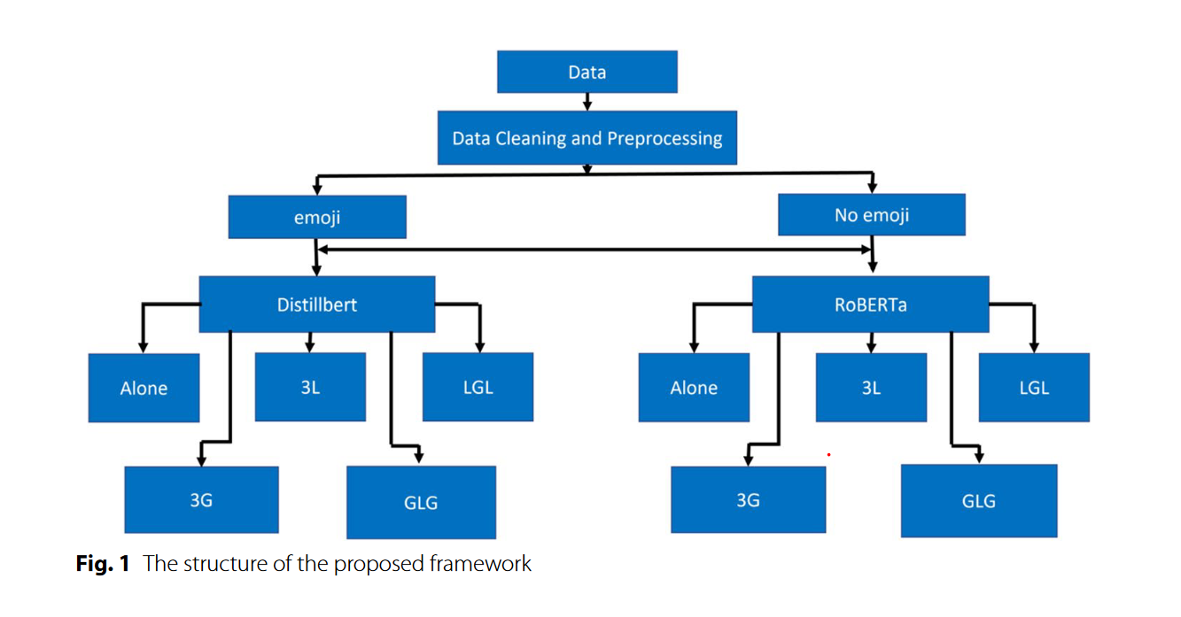

Slide 6
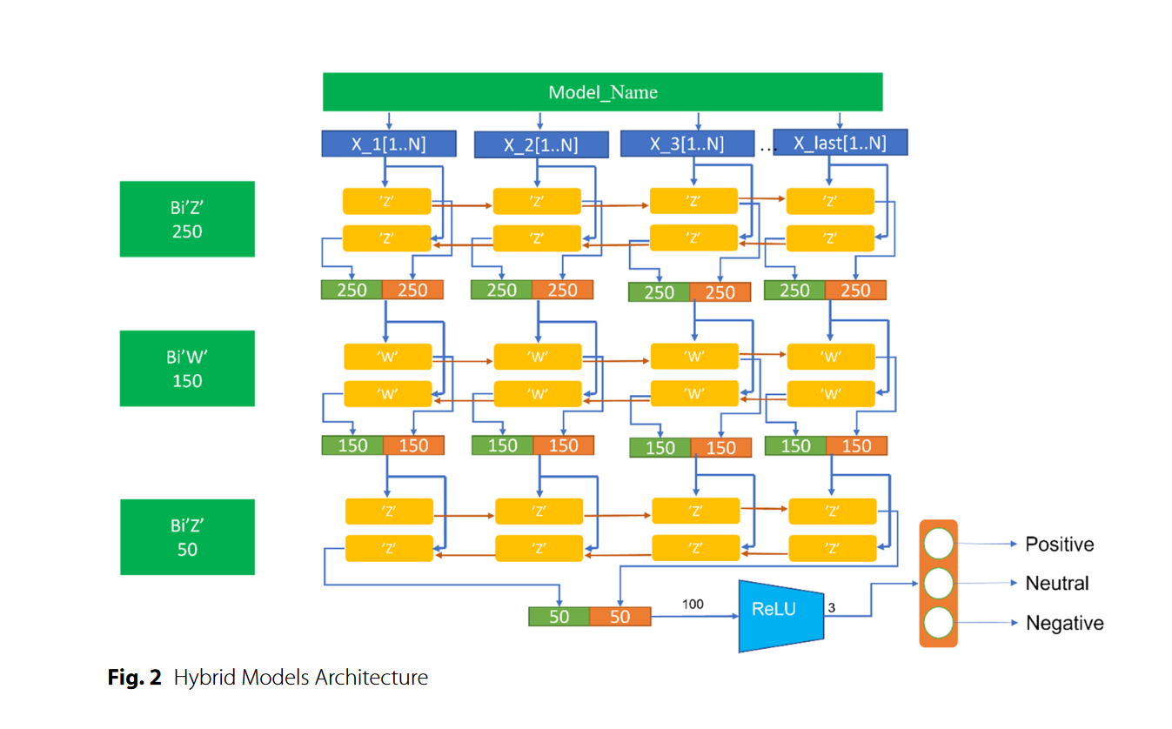

Slide 7
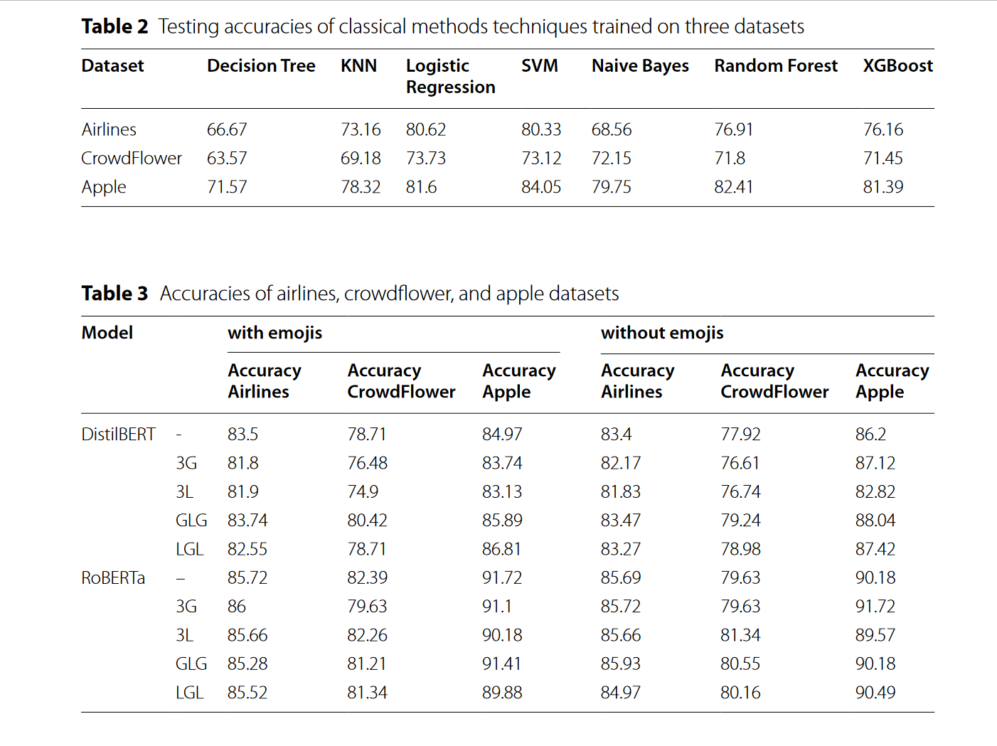
Results and Discussion

Slide 8
Conclusion
The study introduced a framework for predicting user emotions from tweets using BERT models and classical machine learning.
Three datasets were used
Hybrid models with BERT and BiGRU layers demonstrated strong performance, especially with large datasets.
RoBERTa models generally outperformed DistilBERT, achieving higher accuracy.

Slide 9
Future Work
Extend this work in the future by combining it with classical text classification algorithms.
To increase the performance of the present system, the most up-to-date approaches to feature extraction and feature selection will be integrated with traditional methods.

Slide 10
Limitations
Dataset Dependency
Lack of Interpretability

Slide 11
Thank you!

